Slide 1
INT220
Server Side Scripting
Lecture 0
Welcome!!!!

Slide 2
Vision
To be a globally recognized school through excellence in teaching, learning, and research for creating Computer Science professionals, leaders, and entrepreneurs of the future contributing to society and industry for sustainable growth.

Slide 3
Mission
To build computational skills through hands-on and practice-based learning with measurable outcomes.
To establish a strong connect with industry for in-demand technology driven curriculum.
To build the infrastructure for meaningful research around societal problems.
To nurture future leaders through research-infused education and lifelong learning.
To create smart and ethical professionals and entrepreneurs who are recognized globally

Slide 4
Course Details
Course Code:- INT220
LTP:- 2 0 2 [2 lectures, 2 practical's /week]
Credits:- 3

Slide 5
Assessment/ Evaluation Scheme
Attendance: 5%
CA: 45%
MTT: No MTT
ETP: 50%

Slide 6
Assessment/ Evaluation Scheme
CA1: Visual Implementation (30 Marks)
CA2: Visual Implementation (30 Marks)
CA3: Project Mandatory (30 Marks)
(Note: The CA3 will be allocated in 3rd week and student will submit it in 11th week)
End Term Practical: 100 Marks

Slide 7
CA3 Project Rubrics
Functionality and Deployment(5),
User Interface(5),
Novelty/Uniqueness(5),
Documentation(5),
Presentation(5),
Client Involvement(5)
NOTE:- Client involvement depicts the revenue generated by the students through the client. Students will be required to submit the proof of revenue generation

Slide 8
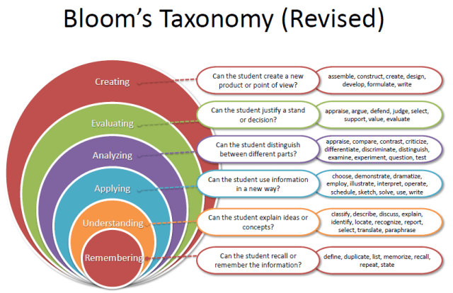
Revised BLOOM’S Taxonomy

Slide 9
Course Details
L:2 T:0 P:2 Credits: 3
Course Outcome’s:
CO1 :: employ web development concepts including server setup and basic programming syntax
CO2 :: use PHP arrays and functions to enhance web development efficiency.
CO3 :: develop PHP form handling, validation, and sanitization techniques for secure data processing.

Slide 10
Course Details
L:2 T:0 P:2 Credits: 3
Course Outcome’s:
CO4 :: employ PHP techniques for enhanced web functionality, encompassing cookies, sessions.
CO5 :: apply object-oriented programming principles in PHP for enhanced code organization and functionality.
CO6 :: demonstrate proficiency in MySQL fundamentals including database basics, SQL queries and functions.

Slide 11
Program Outcomes
PO1: Engineering knowledge: Apply the knowledge of mathematics, science, engineering fundamentals, and an engineering specialization to the solution of complex engineering problems.
PO2: Problem analysis: Identify, formulate, research literature, and analyze complex engineering problems reaching substantiated conclusions using first principles of mathematics, natural sciences, and engineering sciences.
PO3: Design/development of solutions: Design solutions for complex engineering problems and design system components or processes that meet the specified needs with appropriate consideration for the public health and safety, and the cultural, societal, and environmental considerations.
PO4: Conduct investigations of complex problems: Use research-based knowledge and research methods including design of experiments, analysis and interpretation of data, and synthesis of the information to provide valid conclusions.

Slide 12
Program Outcomes
PO5 : Modern tool usage: Create, select, and apply appropriate techniques, resources, and modern engineering and IT tools including prediction and modeling to complex engineering activities with an understanding of the limitations.
PO6: The engineer and society: Apply reasoning informed by the contextual knowledge to assess societal, health, safety, legal and cultural issues and the consequent responsibilities relevant to the professional engineering practice.
PO7: Environment and sustainability::Understand the impact of the professional engineering solutions in societal and environmental contexts, and demonstrate the knowledge of, and need for sustainable development.
PO8: Ethics::Apply ethical principles and commit to professional ethics and responsibilities and norms of the engineering practice.
PO9: Individual and team work::Function effectively as an individual, and as a member or leader in diverse teams, and in multidisciplinary settings.

Slide 13
Program Outcomes
PO10: Communication: Communicate effectively on complex engineering activities with the engineering community and with society at large, such as, being able to comprehend and write effective reports and design documentation, make effective presentations, and give and receive clear instructions.
PO11: Project management and finance: Demonstrate knowledge and understanding of the engineering, management principles and apply the same to one’s own work, as a member or a leader in a team, manage projects efficiently in respective disciplines and multidisciplinary environments after consideration of economic and financial factors.
PO12: Life-long learning: Recognize the need for, and have the preparation and ability to engage in independent and life-long learning in the broadest context of technological change.
PO13: Competitive Skills: Ability to compete in national and international technical events and building the competitive spirit along with having a good digital footprint.

Slide 14
Program Specific Outcomes
PSO1: Apply acquired skills in software engineering, networking, security, databases, intelligent systems, cloud computing and operating systems to adapt and deploy innovative software solutions for diverse applications.
PSO2: Apply diverse IT skills to design, develop, and evaluate innovative solutions for business environments, considering risks, and utilizing interdisciplinary knowledge for efficient real-time projects benefiting society.

Slide 15
Unit 1
PHP Fundamentals : PHP, MySQL and XAMPP Installation, PHP Basic Syntax, PHP Data Types, PHP Variables, PHP Constants, PHP Expressions, PHP Operators, PHP Control Structures, PHP Loops

Slide 16
Unit 2
PHP Arrays and Functions : PHP Enumerated Arrays, PHP Associative Arrays, PHP Multi-Dimensional Arrays, PHP Functions, Syntax, Arguments and Variables, References, Pass by Value & Pass by references, Return Values, Variable Scope, PHP include() and PHP require()

Slide 17
Unit 3
PHP Forms : PHP Form handling, PHP GET and POST, PHP Form Validation, PHP Form Sanitization

Slide 18
Unit 4
PHP Cookies, Sessions and Strings Handling : PHP Cookie Handling, PHP Session Handling, PHP Login Session, Strings and Patterns, Matching, PHP Sending Emails, PHP File Uploading, PHP Filters, PHP Error Handling

Slide 19
Unit 5
Object Oriented Programming in PHP : Defining PHP Classes, Creating Objects in PHP, Calling Member Functions, Constructor Functions, Inheritance, Function Overriding, Interface, Abstract Classes

Slide 20
Unit 6
Basic MySQL and SQL Queries : Database Basics, Indexes, PHP MyAdmin, Connect & Pconnect, MySQL Create, MySQL Insert, MySQL Select, MySQL Update, MySQL Delete, MySQL Truncate, MySQL Drop, WHERE condition, Order By and Group By, Having, LIKE, AND OR operators, SQL functions AVG, COUNT, SUM, MIN, MAX, LCASE, UCASE

Slide 21
List of Practicals
Installation and configuration of XAMPP Web Server, PHP and MySQL.
Use data types of PHP including String, Integer, Float, Boolean, Array, Object and Resource.
Use Constants in PHP and make them global.
Use Various types of operators including Arithmetic, Assignment, Comparison, Increment/Decrement, Logical, String and array operators.
Use PHP control structures - if, if...else, if...elseif.else, switch statement and Loops.
Implement the concept of two-dimensional arrays.

Slide 22
List of Practicals
Create a user-defined function in PHP, PHP function arguments, and various types for passing arguments in functions- call by value, call by reference.
Use of PHP include and require statements.
Design HTML forms with PHP including validations using GET and POST.
Use the concept of PHP cookies, sessions and strings handling including filter functions.
Use object oriented concepts in PHP
Use the file handling functions.
Design a Web Page with database connectivity using MySQL and PHP

Slide 23
Books
Text Books:
UNLOCK PHP 8: FROM BASIC TO ADVANCED by RONI SOMMERFELD, BPB PUBLICATIONS.
References:
PHP BEGINNERS PRACTICAL GUIDE by PRATIYUSH GULERIA, BPB PUBLICATIONS

Slide 24
Softwares
Editor-VS-Code
Local Web Server-XAMPP

Slide 25
MOOCs/Competition
Building Web Applications in PHP:
https://www.coursera.org/learn/web-applications-php

Slide 26
Open Education Resources
https://www.w3schools.com/php/php_install.asp
https://www.tutorialrepublic.com/php-tutorial/php-arrays.php
https://www.youtube.com/watch?v=bOqTCDfc7Tk
https://www.tutorialrepublic.com/php-tutorial/php-form-validation.php
https://www.youtube.com/watch?v=UZcVUfaby9U
https://www.php.net/manual/en/language.oop5.php
https://www.coursera.org/learn/database-applications-php?irclickid=XLt0rjwQOxyPWfrTyQuvwH6UkC0VgQTm1o9zw0&irgwc=1&utm_medium=partners&utm_source=impact&utm_campaign=315774&utm_content=b2c#modules

Slide 27
Next Class: Introduction to PHP

Slide 28
Introduction
PHP stands for Hypertext Preprocessor.
It is a very popular and widely-used open source server-side scripting language to write dynamically generated web pages.
It was originally created by Rasmus Lerdorf in 1994.
It was initially known as Personal Home Page.
PHP is a server-side scripting language that is embedded in HTML.

Slide 29
Why Learn PHP?
PHP one of the most preferred languages for creating interactive websites and web applications. PHP scripts can be easily embedded into HTML.
With PHP, you can build
Web Pages and Web-Based Applications
Content Management Systems, and
Ecommerce Applications etc.
A number of PHP based web frameworks have been developed to speed-up the web application development. The examples are WordPress, Laravel, Symfony etc.

Slide 30
Introduction(Cont…)
Versions:
PHP Version 1.0
PHP Version 2.0
PHP Version 3.0
PHP Version 4.0
PHP Version 5.0
PHP Version 6.0
PHP Version 7.0
PHP Version 8.0 -> 8.3
For more information, check :
https://php.watch/versions

Slide 31
Introduction(Cont…)
A PHP interpreter, which can be implemented as a module, is commonly used to process PHP code on a web server.
The outcome of the interpreted and executed PHP code – which is an HTML data, CSS, JavaScript, images – would make up the entirely or portion of an HTTP response on a web server.
PHP scripts are executed on the server and the result is sent to the web browser as plain HTML.
PHP can be integrated with the number of popular databases, including MySQL, Oracle, Microsoft SQL Server, Sybase, and so on.
PHP files have extension ".php“.

Slide 32

Introduction(Conti…)
ele”PHP”ant

Slide 33
What you can do with PHP
You can generate pages and files dynamically.
You can create, open, read, write and close files on the server.
You can collect data from a web form such as user information, email, phone no, etc.
You can send emails to the users of your website.
You can send and receive cookies to track the visitor of your website.
You can store, delete, and modify information in your database.
You can restrict unauthorized access to your website.
You can encrypt data for safe transmission over internet

Slide 34
Advantages over other languages
Easy to learn: PHP is easy to learn and use. For beginner programmers who just started out in web development, PHP is often considered as the preferable choice of language to learn.
Open source: PHP is an open-source project. It is developed and maintained by a worldwide community of developers who make its source code freely available to download and use.
Portability: PHP runs on various platforms such as Microsoft Windows, Linux, Mac OS, etc. and it is compatible with almost all servers used today such Apache.
Fast Performance: Scripts written in PHP usually execute or runs faster than those written in other scripting languages like ASP, Ruby, Python, Java, etc.
Vast Community: Since PHP is supported by the worldwide community, finding help or documentation related to PHP online is extremely easy.

Slide 35
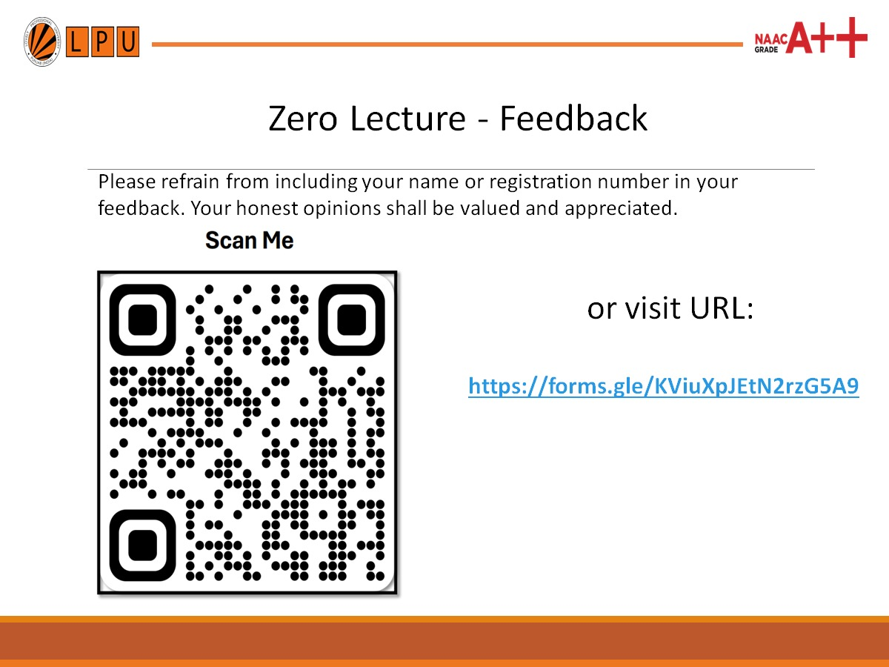

Slide 36
Thank You

